Slide 1
HASC Workshop #2: Life After Death
By:
Mualana
Syed Aqeel Shah

Slide 2
Womb of Mother
Four Stages of Life
Physical World (like this one)
World of Soul (Barzakh)
Day of Resurrection

Slide 3
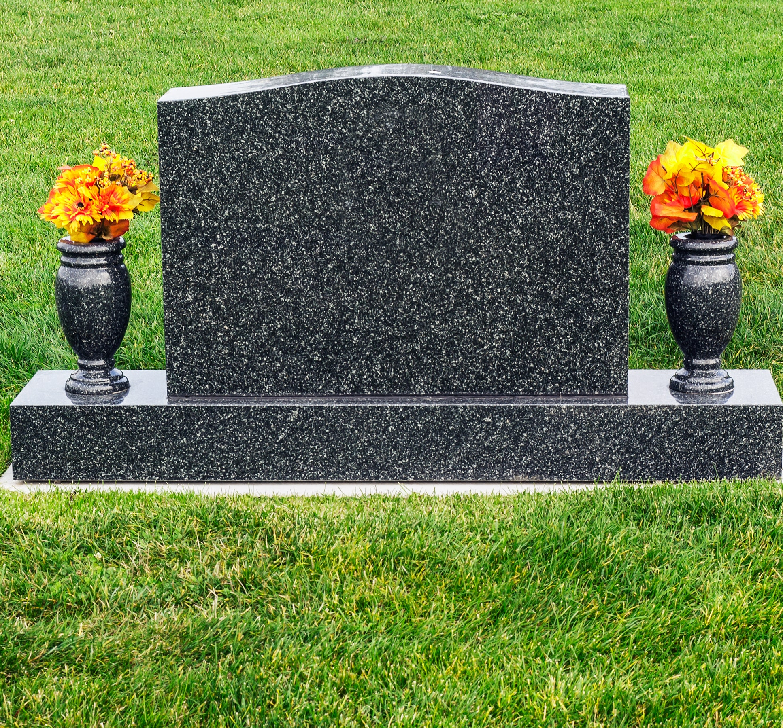
What Happens When Someone Passes Away?
From medical point of view, a person whose breathing and heartbeat has completely stopped is considered dead.

Slide 4
What Happens When Someone Passes Away?
Many changes occur immediately after death.
For example, the temperature of the body drops to that of its surroundings, the muscles of the body become stiff, the circulation of the blood stops and produces reddish-purple discoloration in the lowest par t of the body, and finally the bacteria and other tiny organisms grow on the corpse and cause it to decay.

Slide 5
Islamic Belief on Death:
In Islam, death is not the end of life, but it is a transition to start of another kind of life.
A large number of Quranic verses and ahadith are there which clearly explain the philosophy of life and death.
When someone passes away, after the burial in accordance with sharia, the dead body is place in the grave.
Though the body is in the grave, the spirit will be in a place called Barzakh.

Slide 6
Hardship (Occasion) of Death:
The time when one experiences the pangs of death.
Adeela indal-Maut (Satanic thought in death).
Wahshat al-Qabr (Fear and horror of the Grave)
Constriction in the Grave
The Questioning by Munkar and Nakeer
Barzakh
Day of Judgement

Slide 7
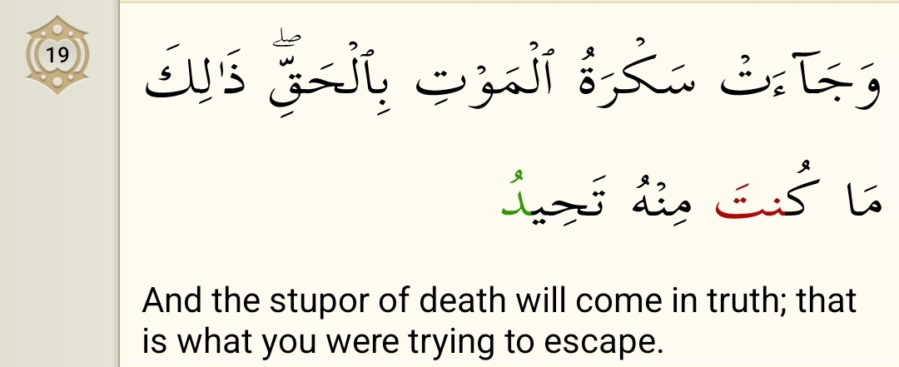
The time when one experiences the pangs of death.
This is an extremely hard time. On one side there is the intensity of pain and illness, the tongue becomes mute and the body refuses to respond.
On the other hand, the crying and wailing relatives and the thought of being separated from them forever, the grief of the children becoming orphans, separation from one's mate and life-partner and from wealth and other worldly goods (in the collection of which one had spent his lifetime): the agony of death, combined with these hardships to be faced after death, all cause this time to be painful beyond imagination.
Chapter 50:19

Slide 8
Adeela indal-Maut (Satanic thought in death).
This is the turning away from the truth to the false and wrong at the time of death.
This is because Satan approaches men at the time of their death creating and raising doubts in their minds to the extent that one's correct faith may be completely shaken.

Slide 9
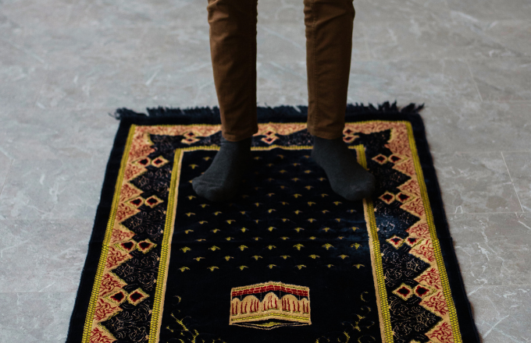
Wahshat al-Qabr (Fear and horror of the Grave)
This is more severe, and fearful than the previous occasions. When the body is brought near the grave, it should not be put into it at once.
It is recommended to perform two rakats Mustahab prayer known as Salatul Wahshat because for the dead person them most horrifying and difficult is the first night. This prayer is performed between Maghrib and Isha.

Slide 10
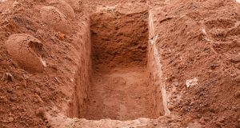
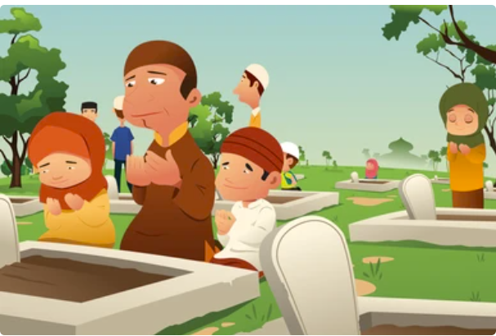
Constriction in the Grave
This is also a difficult time.
The grave calls out everyday. “I am the rest-house of the travelers. I am a house of horror and also of Respect.”
For some, the grave will be a garden from amongst the gardens of Heaven and for others a pit from the pits of Hell.

Slide 11
The Questioning by Munkar and Nakeer
Who is your Creator?
1
The names of these two angels are Munkir and Nakeer. According to the reports from Imams, in the Barzakh man is interrogated about his faith and belief, and deeds.
Who is your Prophet?
2
What is your religion?
3
What is your Book?
4
Who is your Imam?
5

Slide 12
Barzakh
The first stop in Barzakh is the grave.
As soon as we die, the soul enters the stage of Barzakh which literally means a ‘barrier’ between two things. In other words, it means that Allah (swt) has placed a curtain or an intermediary stage between this world and the Hereafter.

Slide 13
Barzakh
The Holy Quran has used the word Barzakh to indicate the life between death and the Resurrection.
Barzakh is followed by the Day of Resurrection. Everyone who has died so far, good or evil, old or young is currently in Barzakh.
They are either enjoying a taste of paradise or suffering temporary punishment, and all of them are ‘waiting’ for the Day of Judgement.

Slide 14
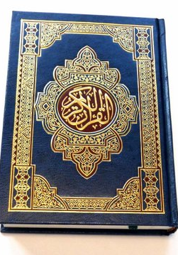
Barzakh in Holy Quran
In the Holy Quran, Barzakh has been mentioned numerous times:
Chapter 23: 100
Chapter 25: 53
Chapter 40:46
Chapter 55: 20

Slide 15
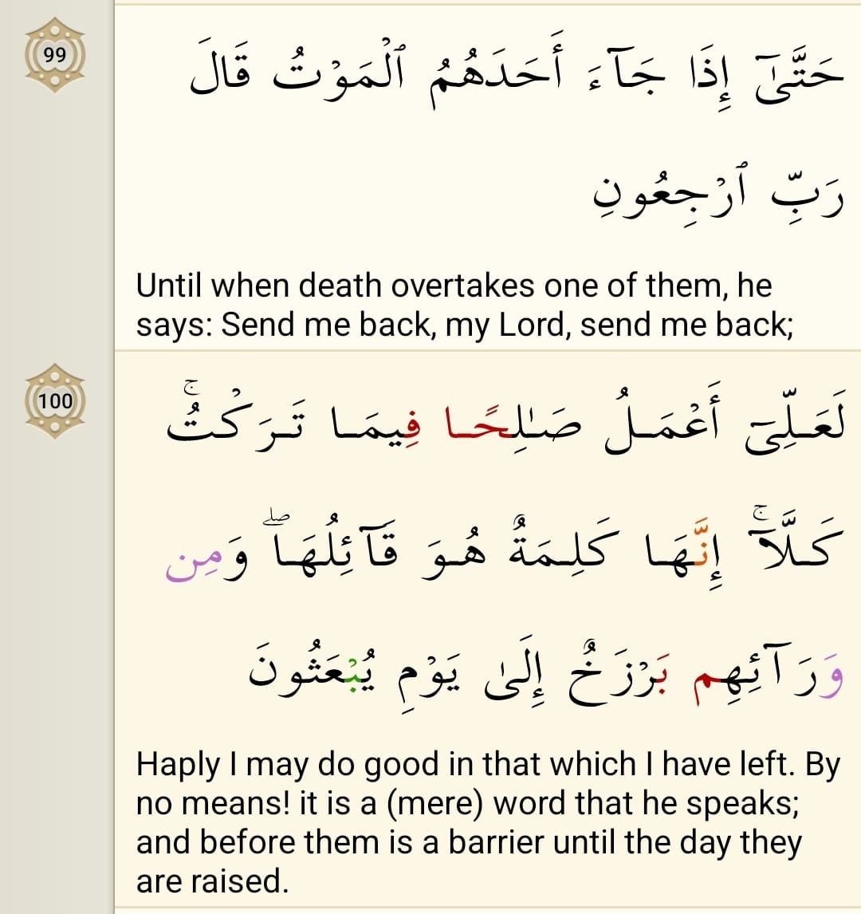
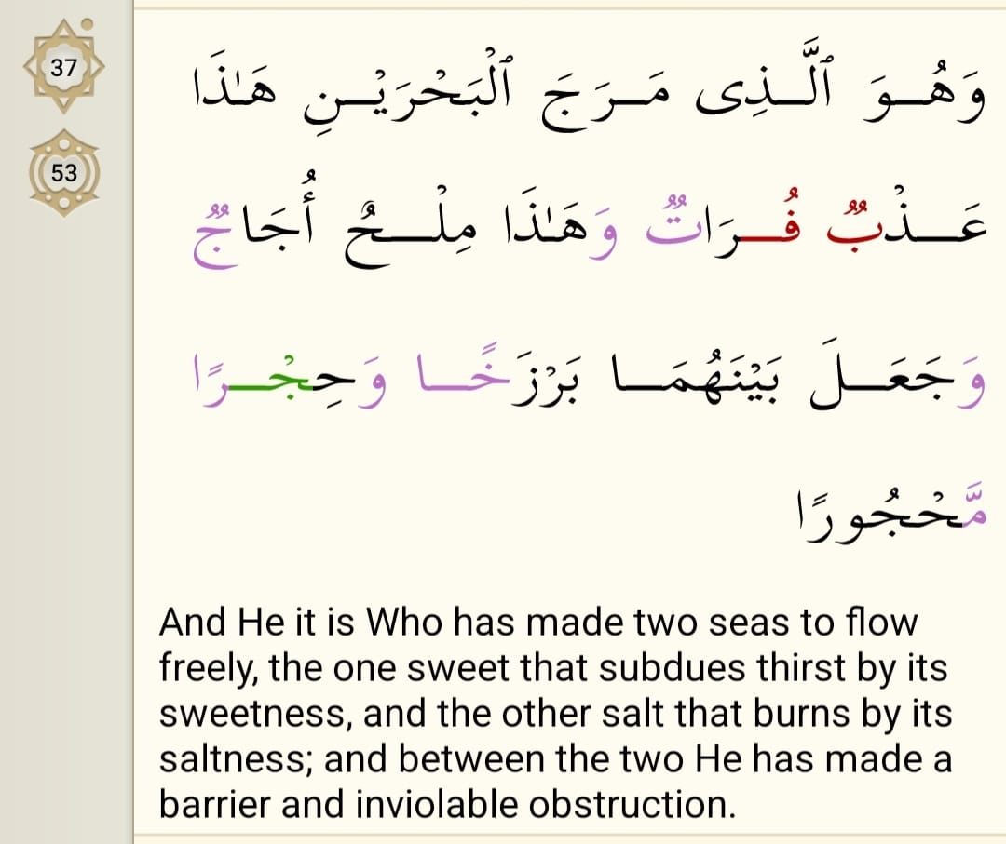
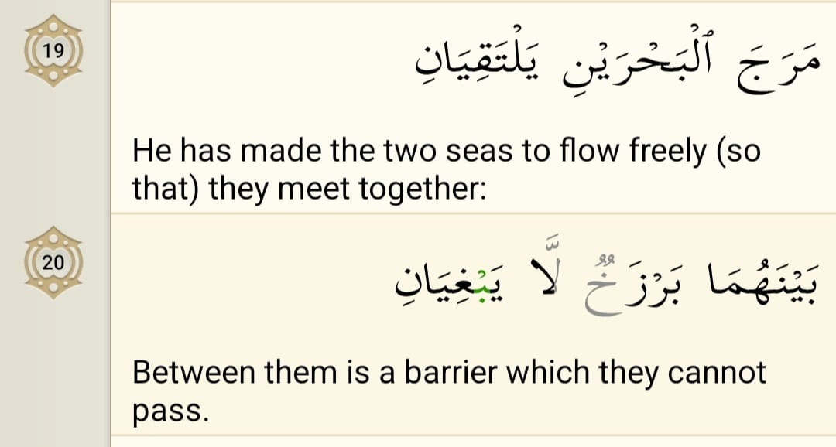
Chapter 23: 100
Holy Quran
Chapter 25: 53
Chapter 55: 19-20

Slide 16
Qur’anic Description of Reward and Punishment in Barzakh
This is one of those verses of Qur’an, which testify to punishment in Barzakh. This verse refers to those people of the pharaoh who drowned in the Nile. Ever since that day, they are regularly brought near fire every morning and every evening. This will continue till the Day of Judgement whereafter they will be given the severest punishment.
Imam Ja'far al-Sadiq (a) says that there is no morning or evening in the Hereafter, and that the said punishment in morning and evening refers to the world of Barzakh.
Chapter 40:46

Slide 17
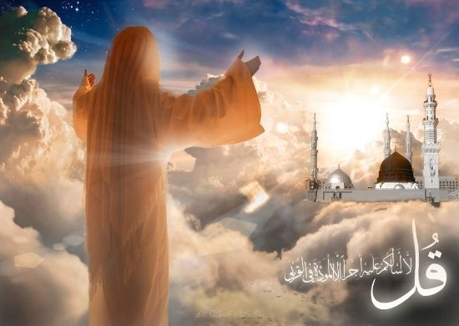
Barzakh:
In Hadiths
In some hadiths, the word 'Barzakh' is used to mean an interval between this world and the hereafter.
For instance, according a hadith from Imam Ja’far al-Sadiq (a), all (true) Shiites will go to the Heaven in the hereafter due to the A’imma intercessions, and, the hadith goes on, 'I swear to Allah (swt) that I fear about you in Barzakh’.

Slide 18
Barzakh:
In Hadiths
A person asked him about Barzakh, and Imam (a) answered: '[it is] the grave, from one's death to the Day of Judgment.
This latter statement implies that the world of grave is the world of Barzakh —indeed, grave in this hadith does not mean a certain hole in the earth; it is a metaphor for Barzakh.

Slide 19
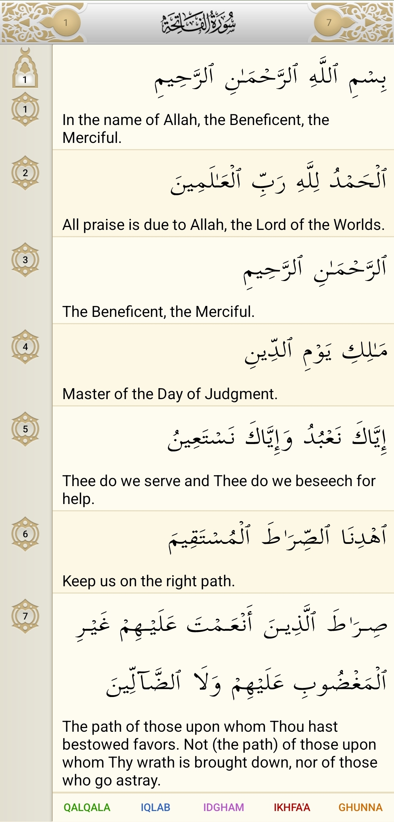
Day of Judgement
It is the harshest and severest. There are fifty stations in which you must travel through in the Day of Judgement; each more difficult than the previous one.
Imam Jafar as-Sadiq (a.s.) says about the effects of remembering death and the Resurrection Day:
Its remembrance suppresses the inordinate desires.
It uproots the very foundation of negligence and apathy,
With the reminding of Allah’s promise, it strengthens man’s heart.
It softens the hard mentality of man.
It demolishes the banners of inordinate desires and transgression.
It suppresses the evil of greediness and makes the world humble before one’s eyes.
The visit to the graves is therefore recommended so that we would be reminded of our death. We all know that we recite the following Sura Fatiha Verse 4, several times in our daily Prayers (Namaz) during day and night, so that we are reminded of the Resurrection Day.

Slide 20
Bibliography:
Chapter 20 : Third Phase of our existence. Shiavault. (n.d.). https://www.shiavault.com/books/basic-beliefs-of-islam/chapters/20-chapter-20-third-phase-of-our-existence/
Barzakh (purgatory) - the stage between this world and the hereafter ... (n.d.-a). https://www.al-islam.org/hereafter-maad-sayyid-abdul-husayn-dastghaib-shirazi/barzakh-purgatory-stage-between-world-and
Barzakh Life After Death ". Rida. (n.d.). https://al-rida.net/knowledge-base/barzakh-life-after-death/
Life after death in Islam: The concept and the 14 stages of Afterlife. Zamzam Blogs. (2022, December 12). https://zamzam.com/blog/life-after-death-in-islam/
Stages of the hereafter, the path to eternity | al-islam.org. (n.d.-b). https://www.al-islam.org/stages-hereafter-path-eternity-yasin-t-al-jibouri

