Slide 1
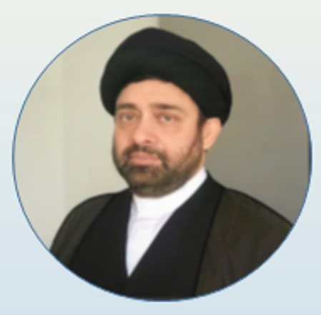
HASC Workshop: Salaah
By:
Mualana
Syed Aqeel Shah

Slide 2
It is compulsory to perform Wudhu, prior to performing Salaah.

Slide 3
How to Perform the Daily Prayers
It is obligatory to perform the following five prayers every day during the prescribed times:
Salat al-Fajr (Dawn prayer), which consist of two units (each unit of prayer is called a rak`ah).
Salat al-Zuhr (Midday prayer) consisting of four units.
Salat al-`Asr (Afternoon prayer) consisting of four units.
Salat al-Maghrib (Dusk prayer) which consist of three units.
Salat al-`Isha (Night prayer) consisting of four units.

Slide 4
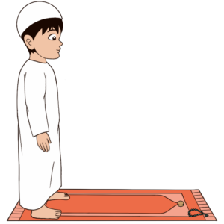
Recommended Acts:
Stand upright facing the Qiblah (direction of Mecca) and recite the Adhan, dua after Adhan and Iqama.

Slide 5
How to Perform Four Raka’ah Obligatory Salaah
The Zuhr Salaah is the 4 raka’ah (unit of prayer) obligatory prayer of the five daily prayers.

Slide 6
The First Rak`ah
1. Stand upright facing the direction of Al-Ka’bah. This position is called Qiyaam and the direction is called Qiblah in Arabic.

Slide 7
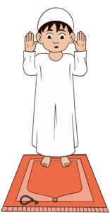
The First Rak`ah
Make Niyyah (solemn intention) in your heart and your mind: “I am offering Zuhr Salaah (noon prayer), of four (4) rak`ah’s (units) seeking closeness to God”.
Raise your hands to your ears and say: “ٱللَّٰهُ أَكْبَرُ” (Allahu Akbar). This means: “Allah is the Greatest”. This is called Takbiratul Ihram.

Slide 8
The First Rak`ah
After this, bring your hands down and remain in the standing position (Males to stands with his feet apart from 4 to 8 inches; females to stand with her feet close to each other) while performing the recitations in the next step, Qira’ah. Recite Suratul Fatihah (the opening) of the Holy Qur’an:
بِسْمِ اللهِ الرَّحْمنِ الرَّحِيمِِ Should always be louder.
بِسْمِ اللهِ الرَّحْمنِ الرَّحِيمِِ ○ الْحَمْدُ للّهِ رَبِّ الْعَالَمِينَ ○ الرَّحْمـنِ الرَّحِيمِ ○ مَالِكِ يَوْمِ الدِّينِ ○ إِيَّاكَ نَعْبُدُ وإِيَّاكَ نَسْتَعِينُ ○ اهدِنَــــا الصِّرَاطَ المُستَقِيمَ ○ صِرَاطَ الَّذِينَ أَنعَمتَ عَلَيهِمْ غَيرِ المَغضُوبِ عَلَيهِمْ وَلاَ الضَّالِّينَ ○
Transliteration:
“Bismillahir rahmanir rahim Al hamdu lil lahi rabbil ‘alamin. Arrahmanir rahim. Maliki yawmiddin. Iyyaka na’budu wa iyyaka nasta’in. Ihdinas siratal mustaqim. Siratal ladhina an’amta’alaihim, ghairil maghdubi’alaihim wa lad dhallin.”

Slide 9
The First Rak`ah
5. Now, recite any other complete Chapter of the Holy Qur’an. For example: Suratul Qadr (the destiny)
بِسْمِ اللهِ الرَّحْمنِ الرَّحِيمِ ○ إِنَّا أَنزَلْنَاهُ فِي لَيْلَةِ الْقَدْرِ ○ وَمَا أَدْرَاكَ مَا لَيْلَةُ الْقَدْرِ ○ لَيْلَةُ الْقَدْرِ خَيْرٌ مِّنْ أَلْفِ شَهْرٍ ○ تَنَزَّلُ الْمَلَائِكَةُ وَالرُّوحُ فِيهَا بِإِذْنِ رَبِّهِم مِّن كُلِّ أَمْرٍ ○ سَلَامٌ هِيَ حَتَّى مَطْلَعِ الْفَجْرِ ○
Transliteration:
Bismillahir rahmanir rahim. Innaa Anzalnaahu Fiy Laylatil Qadr. Wa Maa Adraaka Maa Laylatul Qadr. Laylatul Qadri Khayrum Min Alfi Shahr. Tanazzalul Malaaikatu War Ruuhu fiyhaa Bi Idhni Rabbihim Min Kulli Amr. Salaamun Hiya Hattaa Matla’Il Fajr.”

Slide 10
The First Rak`ah
6. After completing the second chapter, raise your hands to your ears and say: “ٱللَّٰهُ أَكْبَرُ” (Allahu Akbar).
This means: “Allah is the Greatest”. This is called Takbir.

Slide 11
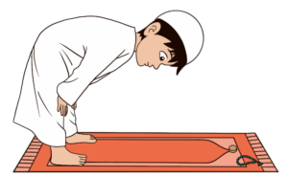
The First Rak`ah
7. Then bow down until the hands can be placed on the knees (females to keep on her thighs above the knees with fingers joined and back in an arch fashion). This position is called Rukoo’
The following dhikr (glorification) should be recited at least once in this position:
سُبْحَانَ رَبِّيَ الْعَظِيمِ وَبِحَمْدِه
Transliteration: “Subhaana rabbiy al-`azeemi wa bihamdih”

Slide 12
The First Rak`ah
8. Stand up from the bowing position and recite:
سَمِعَ اللَّهُ لِمَنْ حَمِدَه
Transliteration: “Sami’Allahu liman hamidah”

Slide 13
The First Rak`ah
9. Raise your hands to your ears and say:
“ٱللَّٰهُ أَكْبَرُ”
This means: “Allah is the Greatest”. This is called Takbir.

Slide 14
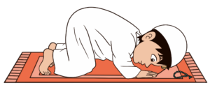
The First Rak`ah
10. Go down for Sujood (prostration). This is the first Sujood.
There should be seven (7) points of contact with the ground, your forehead, both the palms, both knees, and both the big toes.
Put your head between your palms such that your thumbs are inline with your earlobes. The elbows should be raised away from the ground (For females recommended to keep their hands on the ground as close to the body as possible).
Keep your arms away from the sides of the body and the ground.

Slide 15
The First Rak`ah
10. Go down for Sujood (prostration). This is the first Sujood.
The following should be recited in Sujood at least once:
سُبْحَانَ رَبِّيَ الأَعْلَى وَبِحَمْدِه
Transliteration:
“Subhaana rabbiy al-a`laa wa bihamdih”

Slide 16
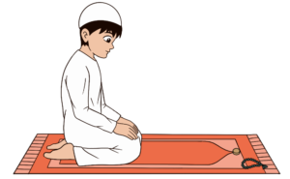
The First Rak`ah
11. After first sujood, raise the forehead and sit up with the ankle of the right foot in the sole of the left foot, with hands resting on the thighs. Then say Takbir, optionally followed by:
أَسْتَغْفِرُ اللّهَ رَبِّي وَأَتُوبُ إلَيْه
Transliteration:
“Subhaana rabbiy al-a`laa wa bihamdih”

Slide 17
The First Rak`ah
12. Repeat the Sujood again. This is the second Sujood. (In the same method as step No.10 above)
13. Sit up for a moment (position of step No.11).
[This completes the first Rak’ah]

Slide 18
The First Rak`ah
14. You now have to rise into a standing position for the second Rak’ah or unit of Salaah while (optionally) reciting:
بِحَوْلِ اللّٰهِ وَ قُـوَّتِهِ أَقُومُ وَ أَقْـعُدُ
Transliteration:
“Bihawlillaahi wa quwwatihi aqoomu wa aq`ud”

Slide 19
The Second Rak`ah
15. After regaining the upright posture, recite Surah al-Fatiha and another complete Surah of the Holy Qur’an followed by Takbir in the same way as the first rak`ah. (The same method as step No.4 to No.6 above)

Slide 20
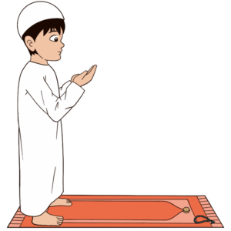
The Second Rak`ah
16.While still standing, raise your hands in front of your face, turning the palms facing upwards, and keeping both the hands and the fingers close together. This is known as Qunut.
[Note: Qunut is not compulsory but highly recommended. You may ask Allah for anything (Dua). It is recommended to read a dua from the Holy Quran.]

Slide 21
The Second Rak`ah
You may recite the following :
رَبَّنَآ ءَاتِنَا فِى ٱلدُّنْيَا حَسَنَةًۭ وَفِى ٱلْـَٔاخِرَةِ حَسَنَةًۭ وَقِنَا عَذَابَ ٱلنَّارِ
[Qur’an, chapter 2, verse 201]
Transliteration:
“Rabbanaa aatinaa fi’d-dunyaa hasanatan wa fi’l-aakhirati hasanatan wa qinaa `adhaab an-naar”

Slide 22
The Second Rak`ah
17. Say Takbir, followed by the ruku`, then the two sujud, as described for the first rak`ah. (In the same method as step No.6 to step No.12 above)
18. After the second sujood, resume the sitting position and recite the Tashahud:

Slide 23
The Second Rak`ah
18. After the second sujood, resume the sitting position and recite the Tashahud: [Con’t]
أَشْهَدُ أَن لَّا إِلٰهَ إِلاَّ اللهُ وَحْدَهُ لَا شَرِیكَ لَه. وَ أَشْهَدُ أَنَّ مُحَمَّدًا عَبْدُهُ وَ رَسُولُهُ. اَللّٰهُمَّ صَلِّ عَلَىٰ مُحَمَّدٍ وَّ آلِ مُحَمَّدٍ
Transliteration:
“Ash hadu al laa ilaaha illallaahu wahdahu laa shareeka lah, wa ash hadu anna Muhammadan `abduhu wa rasuluh Allaahumma salli `alaa Muhammadin wa Aali Muhammad”
[This Completes the Second Rak’ah]

Slide 24
The Second Rak`ah
19. You now have to rise into a standing position for the third Rak’ah or unit of Salaah while (optionally) reciting:
بِحَوْلِ اللّٰهِ وَ قُـوَّتِهِ أَقُومُ وَ أَقْـعُدُ
Transliteration:
“Bihawlillaahi wa quwwatihi aqoomu wa aq`ud”

Slide 25
The Third Rak`ah
20. After regaining the upright posture, recite al-Tasbihat al-Arba`ah three times (x3), as follows:
سُبْحَانَ اللهِ وَ الْحَمْدُ لِلّٰهِ وَ لَا إِلٰهَ إِلاَّ اللهُ وَ اللهُ أَکْبَـرُ
Transliteration:
“Subhaanallaahi wa’l hamdu lillaahi wa laa ilaaha illallaahu wallaahu akbar”

Slide 26
The Third Rak`ah
21. Say Takbir, followed by the ruku`, then the two sujud, as described for the first rak`ah. (In the same method as step No.6 to step No.12 above)
22. After the second sujood, resume the sitting position and recite the Tashahud:
23. Sit up for a moment (position of step No.11 above).
[This completes the third Rak’ah]

Slide 27
The Fourth Rak`ah
24. This is identical to the third rak`ah. (In the same method as step No.20 and No. 22 above)

Slide 28
The Second Rak`ah
25. After the second sujood (prostration), resume the sitting position and recite the Tashahud (as you did at the end of the second rak`ah – in step 18):
أَشْهَدُ أَن لَّا إِلٰهَ إِلاَّ اللهُ وَحْدَهُ لَا شَرِیكَ لَه. وَ أَشْهَدُ أَنَّ مُحَمَّدًا عَبْدُهُ وَ رَسُولُهُ. اَللّٰهُمَّ صَلِّ عَلَىٰ مُحَمَّدٍ وَّ آلِ مُحَمَّدٍ
Transliteration:
“Ash hadu al laa ilaaha illallaahu wahdahu laa shareeka lah, wa ash hadu anna Muhammadan `abduhu wa rasuluh Allaahumma salli `alaa Muhammadin wa Aali Muhammad”

Slide 29
The Second Rak`ah
26. After reciting the Tashahhud recite the Taslim (Salutation):
اَلسَّلَامُ عَلَیْكَ أَيُّـهَا النَّبِيُّ وَ رَحْمَةُ اللهِ وَ بَـرَکَاتُهُ. اَلسَّلَامُ عَلَیْنَا وَ عَلَىٰ عِبَادِ اللهِ الصَّالِحِینَ. اَلسَّلَامُ عَلَیْكُمْ وَ رَحْمَةُ اللهِ وَ بَـرَکَاتُهُ
Transliteration:
“Assalaamu `alayka ayyuhan nabiyyu wa rahmatullaahi wa barakaatuh Assalamu `alaynaa wa `alaa `ibaadillaahis saaliheen Assalamu `alaykum wa rahmatullaahi wa barakaatuh”
27. It is recommended to say Takbir three times thereafter (optional).
[This completes your prayer]

Slide 30
Bibliography:
Asr Salaah. Shia Salaah. (2022, October 31). https://shiasalaah.com/asr-salaah/
Sala1. The Fourteen Infallible PBUH. (2011, June 27). https://masoumeen.wordpress.com/shia-prayer/sala1/
Uqs, & Name. (2019, August 10). Why do we pray salah? the wisdom behind allah’s obligations. Understand Al-Qur’an Academy. https://understandquran.com/pray-salah-wisdom-behind-allahs-obligations/
What is the manner of washing the face, and wiping the head and the feet in Wudu?. Karbala Center for Studies and Research | Home. (n.d.). https://c-karbala.com/en/kcsrs-activities/4000

